Slide 1
Portal 0 Womb Wellness Sacred Waters Class 1
with Star Thomas-Wyse

Slide 2
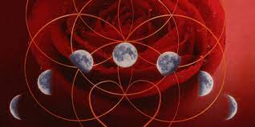
Laying the Groundwork for our practice, Setting our Intention,
Structure and Process
Daily Spiritual Practice, Cleansing, Increasing Vitality
Tracking your Cycle

Slide 3
Calling in Sacred Space

Slide 4
My Intention for this program is to train as many women as I can to:
honor the Divine Feminine in herself, and to teach the next seven generations to do so.
raise her vibratory rate, knowing that as she does, she raises the vibration of the planet and all of humanity.
see this as her Sacred Duty and consider it an honor and privilege to serve her fellow beings in this way.

Slide 5
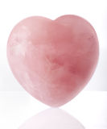
What is Your Intention for this Process?

Slide 6
The focus of this course is a non-violent approach to women’s health, specifically, womb-health. The teachings are the very basic “grass-roots” teachings of the Ancient Mystery Schools. They contain the nuts and bolts of how to utilize the gifts of the planet on which we live to keep our bodies healthy and happy.

Slide 7
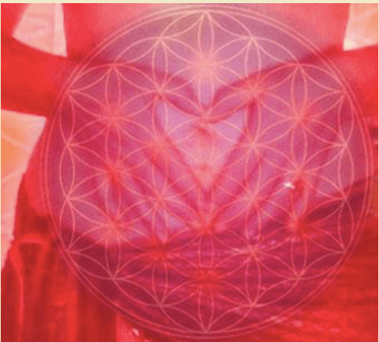
The path back to your power is through your body. Your body holds the key. This is the very thing that women have forgotten…

Slide 8
Women are sitting on a powder keg of power and don’t even know it. This giant power-tool does what she does. She works tirelessly and constantly behind the scenes under our awareness mostly. And because we may not be consciously aware of what she is doing and how she works, her work may be benefiting us or causing us a lot of pain and distress. But with a bit of knowledge and tweaking, we can harness her energy to serve us in magnificent ways. And I think you all would agree that NOW IS THE TIME…

Slide 9
What we know now…
As a woman you are coded for power, and the journey to realizing the fullness and beauty of that power – your Wild Power – lies in the rhythm and change of your menstrual cycle. The menstrual cycle is a vital and vitalizing system in the female body, yet our understanding of and respect for this process is both limited and distorted. Few women really know about the physiology of their cycle, and many do not see it as an integral part of their health and wellbeing, let alone as a potential guide to emotional and spiritual empowerment. Your Wild Power tells a radical new story about feminine power. It reveals:
•Your inner architecture and the path to power that is encoded in your body
•How to tune in to the rhythm and changes of your menstrual cycle to realize the fullness and beauty of your authority
•Three ‘maps’ to guide you through the energies, tasks and challenges presented as you journey through each cycle
•How to work with your Inner Seasons to pace your energy, calm your nervous system and gain insight into your overall wellbeing
•How to work with your cycle to channel spiritual forces, affirm your expression in the world and achieve a deep sense of belonging. …Your Wild Power will restore women to wholeness and reinstate the full majesty and grace of the Feminine. ~Alexandra Pope…about the book, Wild Power

Slide 10
Suggested Homework:
This book! There are many great books out there!!
Begin Tracking your menstrual cycle.
Day 1 is the first day of bleeding.
If you are no longer bleeding, start at
New Moon today March 2nd!
Track things like emotional state, energy
level, and what happens during the day.

Slide 11
This is the tracking sheet from Red School. It was emailed
to you. You may also want to
invest in a womb journal for
the new year if you haven’t
already done so!

Slide 12
Our bodies are literally keyed into the rhythms of this planet. Moon cycles!
By knowing this rhythm and aligning with it, you harness the energy of the Universe in your very own body. The methods used to do this, have been with us for centuries, but they have been hidden…forgotten. Many of them are so simple that we may take them for granted. Others we may have never heard of. But they are easy to use and learn and when you do, magic happens.

Slide 14
This all turns on at puberty! It works whether you still have a physical womb or not. It works whether or not you can bear children.
It doesn’t turn off at menopause…it expands, coagulates, and literally takes over our being!

Slide 15
Our culture has given us a legacy that, in ancient times, was unheard of. Traditionally, a woman’s menstrual period was a very sacred time, for this is when a woman is most spiritually in tune and most sensitive to her surroundings. She is more open and able to receive messages from Spiritual guidance that will aid her in living a more harmonious existence. Indigenous peoples incorporated systems into their cultures that made use of this time in a powerful way for their tribes. They created a “moon” lodge or “bleeding” lodge where women could learn from other women how to care for their bodies. They could share with other women about their feelings and concerns, and utilize this time to receive messages from higher forms of guidance. They would also do this on behalf of the tribe. As they learned how to care for their bodies in an appropriate way, their wombs, and consequently the earth, remained healthy.
However, as these traditions were lost, life on this planet became a bit more dicey. As these systems have become non-existent, our lives and our relationships have become more and more dysfunctional. Women are no longer connected to their sacred center. They are usually “working” during their bleeding time and experiencing all forms of discomfort during this time that our western world has come to know as symptoms of PMS. Anyone who has had this experience or been on the receiving end of someone having this experience, knows how miserable it can be for everyone. Because women are in such pain, men no longer respect them or their womb space during this time. It is a time we all tolerate, but really don’t enjoy…at all!

Slide 16
But none of this chaos is necessary. PMS and it’s symptoms can become non-existent by re-establishing a few simple practices. And these practices not only benefit women who do them, but men can also benefit from many of the practices that in the past were reserved for women’s circles. None of them are unusual or strange. They are simple, practical practices to keep your energy body fed, your chakras open, and your physical body healthy. These practices help you WAKE UP your Spirit Self and enliven the passion you were born with. I will be introducing you to practices that allow you to access your intuition, anchor your consciousness deeply within your physical body and thereby, enhance your physical experience. These practices will follow the wheel of the year as most of this information is “keyed in” to the cycles and seasons of the Earth itself.

Slide 17
This body of knowledge is based on the premise that in order for our physical body to remain healthy, our spiritual life must be healthy. Much of this information revolves around the health of the female womb space. It has sometimes been called a woman’s second brain, because it controls so many of her hormonal cycles which in turn influence her brain chemistry and ultimately every other aspect of her life. This information is not only important to women, but to all of us who dwell on the planetary womb of the Earth. As long as this part of a woman’s body is disrespected by society, planetary health will suffer. But when this part of a woman’s body is honored and treated with respect by all of humanity, our planet will again begin to flourish. When we all, men and women, begin to remember the birthing place as the center of our universe and our existence, both in a literal and metaphorical sense, we will come to know that when our physical body temples and minds are healthy, we can effect change in our outside world.

Slide 18
In our most recent history, much of this type of “creating” happens under our conscious awareness. With our increased focus on our physical bodies to the exclusion of our energy bodies (seen vs. not seen), with our move, as a society, away from planetary consciousness, spiritual purity and high moral ethics, and with the increased speed toward advanced technology and materialism, the physical/energy body system has begun to falter.

Slide 19
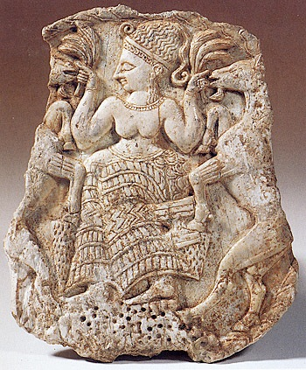
It is imperative for us to understand that this was not the intended plan for our species, and it does not have to continue. The ancient mystery schools provided a wealth of information and techniques for understanding and healing this physical/energetic system. These “highly specialized spiritual-technologies” were passed down to us through our grandmothers’ kitchens, as all of them are simple to do, and easily accessible for anyone…the way Grandmother Earth intended. By re-acquainting ourselves with this information, we re-plant the seed of health in the “womb of our planet” for the next seven generations.

Slide 20
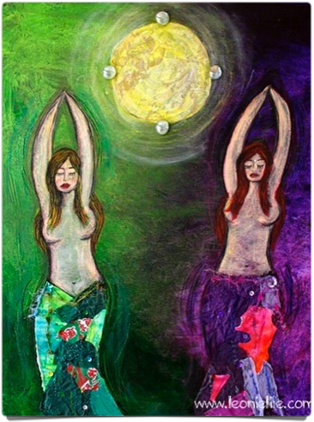
Care of the Womb
Much of the difficulties we experience in our women’s bodies can be avoided by proper care and understanding of how the female body functions. We all know that our bodies are uniquely different than our masculine counterparts. We also know that up until a very short time ago in our own current history, we may not have been taught to honor those differences and utilize them, but to hide them and overcome them. Most of us have tried, sometimes successfully and sometimes very unsuccessfully, to become more like our brothers than ourselves. This has resulted in very harsh and sometimes even violent treatment of the female body in western medicine. Because women have not been taught proper methods for caring for their bodies, the diseases we have acquired have sometimes required desperate methods to keep them at bay. However, as we begin to heal, as we become conscious of our womb’s own wisdom and utilize natural therapies that honor our whole being, the need for these more radical approaches to healing will be unnecessary.

Slide 21
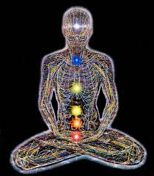
Understanding the Physical/Energetic Link
In order for us to fully understand the importance of caring for our body and how impacts all areas of our life, it is important for us to understand the link between the physical and the energetic world. Embedded within your cells is your life history. Every thought, feeling and act is recorded. There is no way for us to manage all of this information via our minds, so most of us choose to allow our bodies to do the managing for us. This works pretty well when we are making more balanced choices, than non-balanced ones. There are many automatic feeding and cleansing systems in place to allow your body to balance quite a few of the indignities that we shower upon it.
One of the systems that support this management process is the electromagnetic field that surrounds the physical body. This field is the link between the Universal Energy Field that supports all life on this planet, and our body. It literally is a computer that translates Etheric Energy from the field around us and feeds our physical body this energy via the “Chakra System.” The chakras are simply “portals” in our energy field that allow energetic information in and out of your energy field. Even though you may have no knowledge of this system, it has been dutifully working for you all of your life, scanning your body for what it needs and then drawing that in from the Universal Field, and translating it into a form your body can take in. Even though you have no conscious thought of it, your physical body knows this system intimately and communicates with it perpetually. It is the system that imprints our “prayers and intentions” in the Universal Field. Imagine what changes might happen in your life, if you began to simply pay attention to this system and give it what it needs to function. (See the Chakra handout for ways to feed and support this system.)

Slide 22
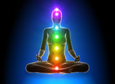
The Human Energy Field
Scientists have now coined the word, “bio-photons” to refer to the tiny particles of actual physical light that make up this electro-magnetic field. This field “Sources” the physical body and keeps it functional. It literally feeds and supports the physical body and actually keeps it functioning in a healthy way. It holds the physical parts together and keeps them bathed in nourishment.
But this field needs attention and support in order to function properly, as well. So how do we feed and Source our Energy Body—the beautiful field of living light that surrounds our physical body and holds it in form? What does it need to be healthy? This is the part of you that houses your soul. So another way to ask that question is, “How do you feed your soul?”

Slide 23
Practices we want to start incorporating…
*A Daily Spiritual Practice – a quiet time, at least 15 minutes, but preferably an hour, to connect with yourself and your intuitive guidance;
*A Healthy diet – live food. I am personally in a process of food transition. You may find this is too much for you. Please make any food changes you desire at your own pace;
*The Use of Energetic Tools – I will be suggesting tools for you to use such as herbal tea, crystals, bath salts, flower essences, essential oils. THIS IS ONE OF THE MOST IMPORTANT PARTS OF THE PROGRAM! All of these tools will help you begin to lift the toxic emotional debris that tends to cling to us and keep us heavy rather than light. They are designed to raise your vibration and eliminate resistance to doing that.
*Guided Meditations and Movement Activations -- Because I will be offering these tools online, I want to make sure the teachings go deeply into your psyche. I have found that moving the body is a great way to “ground” teachings into our core. I will be offering time during and throughout this class for you to “move your body” during class. These are called activations, and trust me, they will activate and enliven the teachings you will be receiving. I will also offer guided meditations to further anchor the teachings within you.

Slide 24
Re-connecting to the Sacred Cycles
Keeping the Sacred Timings is our job as women! One of the main purposes of this course is to put your body back in sync with the natural and sacred rhythms of this planet. Because we are endeavoring to reconnect with the cycles of the planet, spend extra time connecting during the new and full moon windows. This class meets at the new moon or very close to it.
The energy of the new and full moons shows up at least a day before and lingers for a day after the event, so it is always good to pick one of these days to do a little extra altar time and connect with this energy. We are in the third new moon cycle today.
One tradition that lends itself well to this is the Seneca tradition written about in Jami Samms’ book, The 13 Original Clan Mothers. This tradition holds that each of these cycles are governed by or “vibrate with” a special grandmother that holds an aspect of Mother Earth’s personality and helps us understand healthy living practices upon the earth.

Slide 25
The Importance of
A Daily Spiritual Practice
My definition: Anything that opens your heart, that gives you joy, and connects you to your Higher Wisdom and Noble Thought.
I teach this first is because your physical body needs a Spiritual practice of some sort like it needs food! Notice I said Spiritual Practice—not religion. The religions of this planet, up to this point have been vehicles for encouraging and training in Spiritual Practice. However, many have a tendency to focus on the “type of religion” and skip the practice. The practice is the point of religion and not the other way around. If you skip it, you miss it, and your body pays for it.

Slide 26
This…
verses this…

Slide 27
NECESARRY INGREDIENTS
FAITH: Trust in “The-Spirit-that-moves-in-All-Things;”
PRAYER and/or MEDIATATION: A way to communicate with that energy that feels good to you; and
TIME: set aside to make that connection for yourself.
PURPOSE
To raise the vibration of the physical body to keep it healthy;
To Source your energy body to allow you to maintain your presence here on this physical plane as long as you desire.

Slide 28
Things you might want to include in your spiritual practice:
Prayer
Silence
Music
Create an Altar
Meditation
Candles
Dirt time
Chanting
Affirmations
Painting
Reading Sacred Material
Divination Tools
Dancing
Yoga
Sacred Bath
Energetic cleansing tools (essences and oils)
Walking or running
Journaling

Slide 29
Caring for our body in a more balanced way…
Our bodies were intended to be a Temple of Light to house our beautiful Spirits. Because we may not have been given this information earlier in our lives, we may have a little “clean up” to do to get them in tip-top running condition. Some of the tools we will be using during this course are:
Juice Therapy
Live Foods
Nature’s Herbs
Water Therapy
Movement & Breath
Essential Oils & Crystals
Clay infusions & Applications
Frankincense Cleanses
Castor Oil Packs

Slide 30
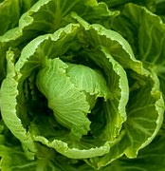
Live Food
This program is based on a commitment to change the things we put into our body. There is a direct correlation between what we consume and the condition of our bodies, our relationships and our lives. This non-violence approach includes all forms of what we consume to the best of our ability.

Slide 31
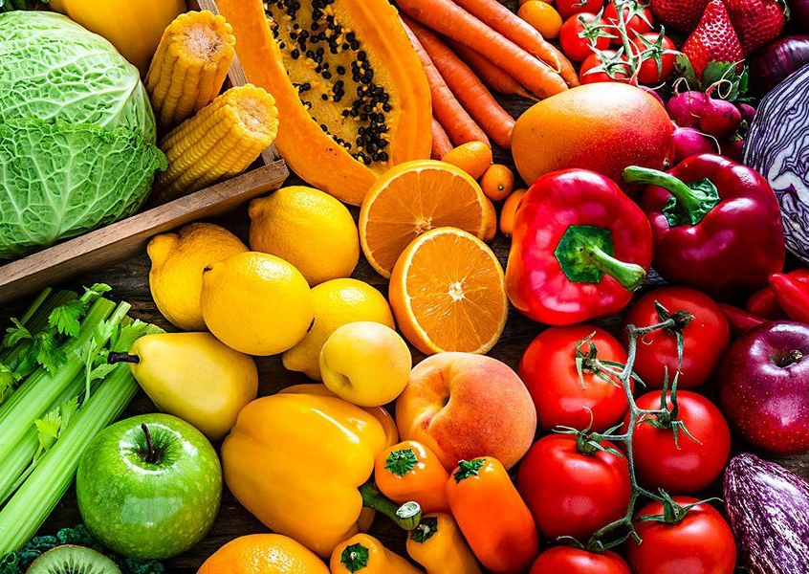
Begin your day with fruit, as much as you care to eat, any way you care to eat it. Fresh or prepared juices and green drinks are also a great way to start your day. It is advised to steer clear of bananas in the beginning, as they can cause constipation.
At lunch have a large raw salad, along with a bowl of vegetable soup, OR a grain and vegetables such as rice, taboulli, couscous, or bulgur wheat that you have soaked in water. This is a good time to take any vitamins, and food or herbal supplements as they digest better if you take them with food. You will have the same for dinner. I strongly urge you to eat ORGANIC whenever you can. It is close to imperative, if you really want your body to begin to respond.
Salads can be topped with vinegar and oil or an organic low-fat dressing. Find one you like so you will stick with it. The goal here is to consume more live food than dead food. It is not necessarily to lose weight, although you probably will. Your magnificent organic computer simply cannot survive on the dead garbage we have been giving it and calling it food. When the body does not recognize something you take in, it wraps it in fat and stores it somewhere until it can figure out what to do with it. Think about all of the stored stuff you are housing, physically and emotionally. Contemplating that could take awhile. So we are going give our bodies a break, by giving it good, healthy, live food that it knows what to do with.

Slide 32
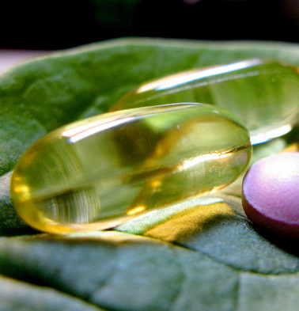
Supplements
Any supplements should be checked with your health practitioner. The following are suggested to begin the program:
A good multi-vitamin supplement
Spirulina or blue-green algae in tablet or liquid form
Vitamin B (especially B-12 if you are meatless)
Vitamin C
Vitamin E
Vitamin D
Flaxseed oil (1-2 tsp. unrefined expelled or cold-pressed
CoQ10
Lecithin
Calcium (1000 mg)
Magnesium
A good digestive enzyme
A good probiotic

Slide 33
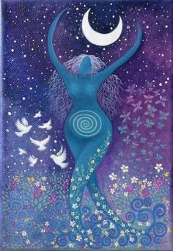
The most valuable and extraordinary gift Creator/Creatrix has given you is your physical body. When treated well it can serve to be a vehicle for your consciousness to do grand and wondrous things upon this planet and was meant to do so.
To squander or demean this gift in any way is such a travesty and yet we do this daily. One of the most significant changes you can make for your spiritual, mental and emotional well-being is to be very conscious of what you take into your body, especially the quality of the food, water and nutrients you consume.

Slide 34
One thing your body does very well is remember. It takes in, records, and stores just about everything you expose it to, on all levels, physical, mental, emotional and spiritual. This is useful when it comes to navigating through your everyday world. However, just like your garage or backroom closet, if it doesn’t get cleaned out regularly, it can “go south” rather quickly. Once again, this is true on all levels.
Physically, it is stored as fat.
Mentally, if you witness, listen to, or even ruminate on information, good or less than enlightening, your mind records it.
Emotionally, if you do not drain off the stress and strain of the day, it can literally become “pain” in your joints, and if left unchecked, can lead to arthritis and other auto-immune maladies.
And we all have experienced the “lack-luster” feeling of becoming spiritually stagnant.

Slide 35
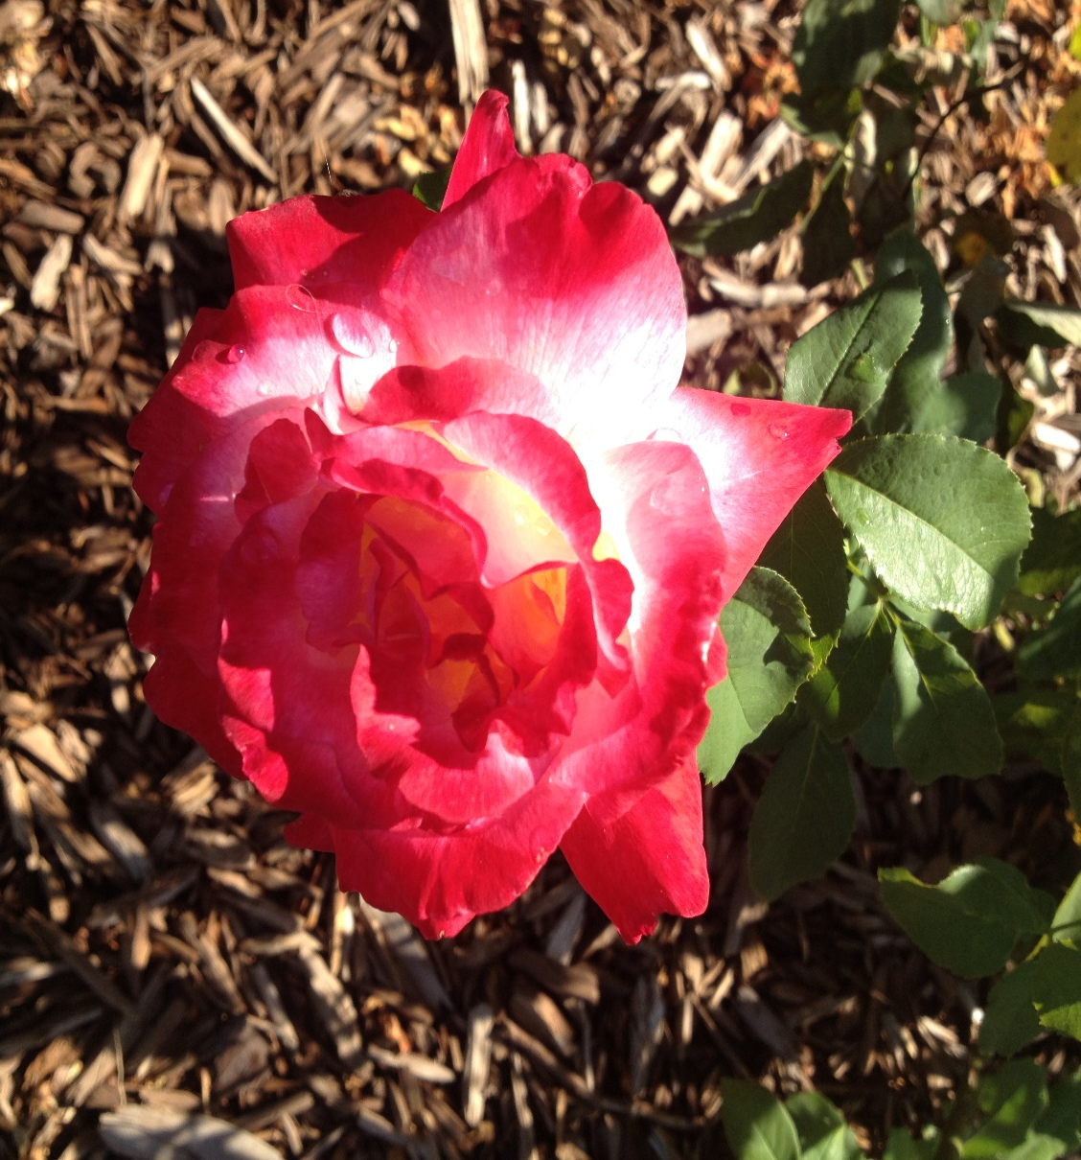
Flower Essences: Flowers are some of the most high-vibrational beings on the planet. They are fully self-realized. Flower essences are very effective vibrational remedies that heal when a few drops of the potentized essence of aromatic flowers are placed on or under the tongue or in a small glass of water that is sipped at regular intervals. Flower essences are primarily recommended to restore balance to mental and emotional states and can offer wonderful support as we work on removing the obstacles that stand in the way of our healing.
The following essences are recommended for going deep into womb or emotional cleansing:
Alpine Lily: Promotes the ability to contact true femininity through ground in the female organs; integration of the feminine with the female sexual and biological self.
Star of Bethlehem: Spiritual receptivity, opening the feminine aspect of the self to higher worlds
Black Eyed Susan: Clearer insight into hidden or buried emotions
Angelica: To feel protected and guided, to feel spiritual guardianship during times of stress
Rose: To lift your vibration to the spiritual realms

Slide 36
Herbal Tonics: Herbal teas or “infusions” are one of the best ways to support your physical body. The best way to make an infusion is to gather your herbs out of your own yard. Bring some water to boiling and then turn it off. Place the herbs in the water to steep for 15 minutes, then strain and drink throughout the day. If you don’t have time for all of that, tea bags work fine. But making your own is a very sweet morning practice you may want to try in the spring. Any herb you find growing naturally in your yard is there for you. Mom knows exactly what you need and always provides it.
Raspberry Leaf Tea is a great womb tonic. Since we are working to clear our womb space during this time it and any form of detox tea you enjoy will work for you. You will receive recipes for herbal teas and other tonics to drink before, during and after your morning work. They are another healthy habit that will keep your body and womb space vital and energized.

Slide 37
Energetic Events
I want to mention a word here about what some would consider “strange” things that might happen as a result of taking this course, and doing these practices (or even attending this class today.) Your body records every event that happens in your life. It is not ignorant. It is your WISDOM! So when you chose to pay a bit of attention to it, (and for women, especially when you pay attention to your womb space) you may have experiences that let you know that you are on the right track. These can show up as simple synchronicities or intuitive hits. For women it can be anything from starting your menses to skipping a cycle altogether and anything in between. You may also start to “hear” your inner voice or the voice of your womb or another part of your body. This is normal and will usually pass after the first month or so. But it might be wise and fun to record the event and even dialog about it in your journal. If it causes you concern, please feel free to contact me.

Slide 38
Womb Health Assessment
Included with this class is a Womb Health Assessment. It will be important for you to spend some time filling it out. You will want to look closely at any difficulties you are currently experiencing and then do the assessment again in a month to see if you can detect change. At the beginning of a process like this sometimes the changes may feel uncomfortable at first as your body begins to throw off years of toxins and unhealthy living. But once this takes place, the outcomes are amazing.

Slide 39
Homework – The Basics
Begin Daily Epsom Salt Baths
Drink 8 glasses of water a day
Begin your day with warm lemon water
Gathering your Energetic tools
Daily Spiritual Practice
Dirt Time
Begin to Shift your Diet
Add Green leafy salads to lunch and dinner
See how much live food you can eat
Pace yourself – seriously start gently
Energetic supports:
Flower Essence: Star of Bethlehem
Essential Oil: Frankincense
Raspberry Leaf Tea
Crystals: Black Tourmaline, Moon Stone, Turquoise

Slide 40
Guided Meditation

Slide 41
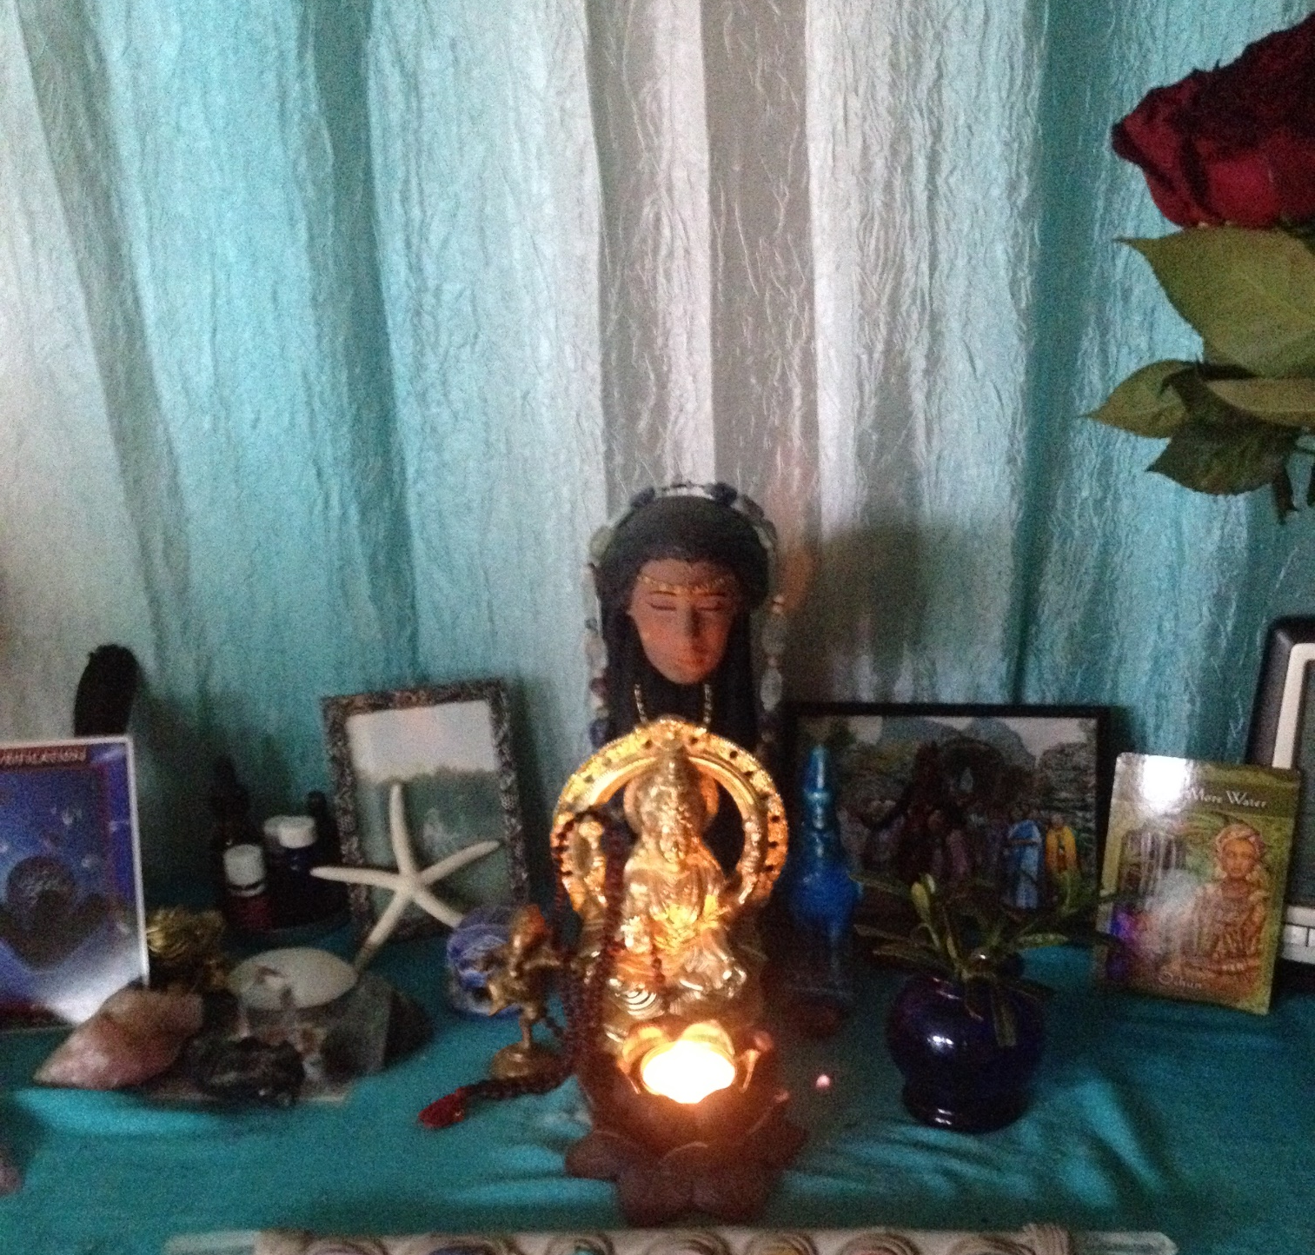
Set an Intention for this moon cycle…

Slide 42
Integration Dance
Ground & Close

